Slide 3
Smart Mi Frame recommendation System
March 2024

Slide 4
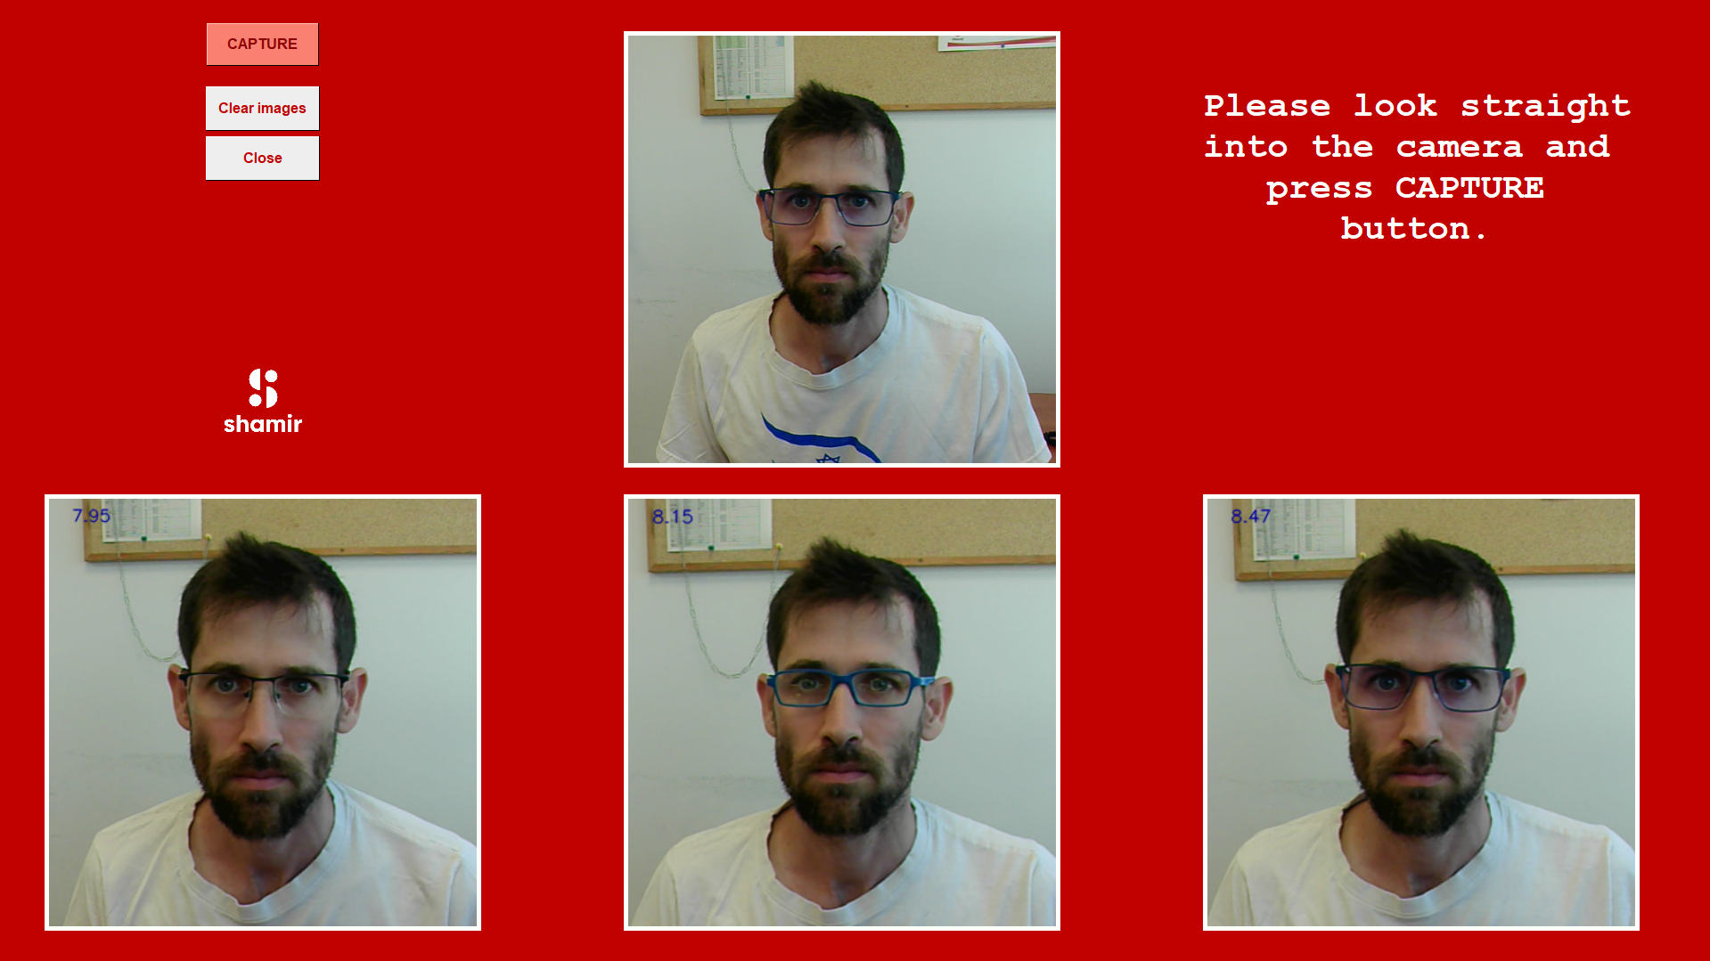

Slide 5
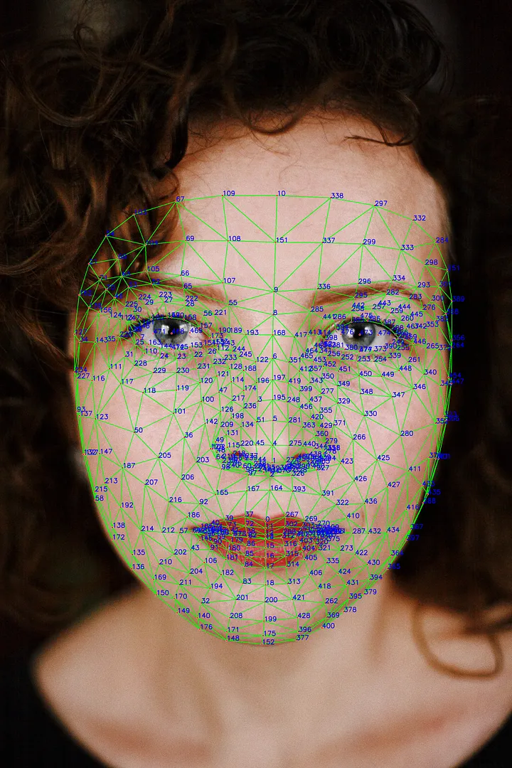
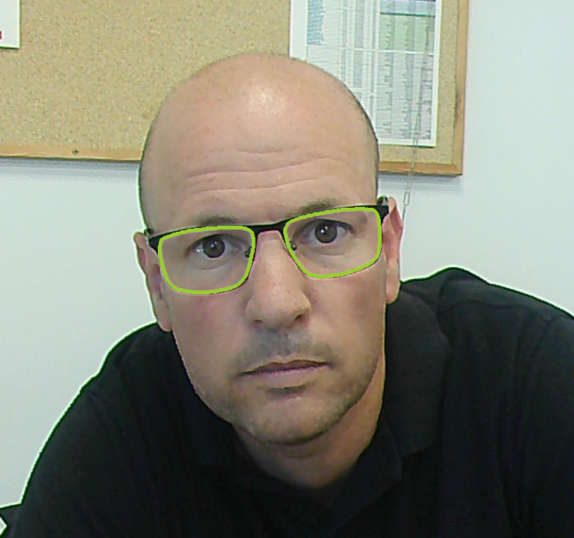
Frame-Face Fit Score Evaluation
Automatic face landmarks detection
Automatic Frame detection

Slide 6
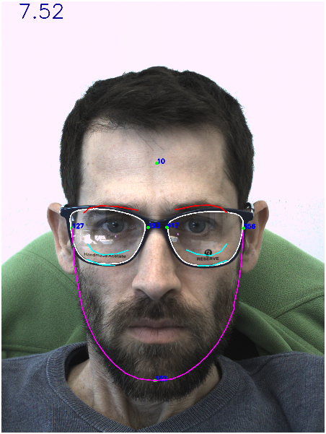
Frame-Face Fit Score Parameters
Face height
Right eyebrow
Left eyebrow
Frame width
Face width
Right lower cheek line
Left lower cheek line
Jaw line

